Slide 1


Conquer The World..!
.

Slide 2


INDEX
1. Abstract.
2. Introduction.
3. General Description.
4. Specific Requirements.
5. Acceptance Area.
5. Algorithms used.
6. Design.
6. Graphical Representation.
7. Code snippet.
8. Output.

Slide 3

ABSTRACT
Aim of The Code :-
The aim is to planning how to move armies from their current positions to the target nations with the goal of minimizing the cost of transportation

Slide 4
INTRODUCTION
PUROPSE :-
The purpose of the code is to developed the system which addresses the logistical challenges faced by a world conquering entity seeking to subjugate nations
It considered the fixed transportation costs associated with routes between nations, the current number of armies in each nation and the number of armies needed to meet the final configuration requirements.

Slide 5
GENERAL DESCRIPTION
Product Function & Overview :-
➢ Participants have a map of the nations of the world and all their available transport routes between them. Each route connects two nations and has a fixed cost per army that uses it. The routes are laid out such that there is exactly one way to travel between any two nations.
➢ Participants know the current position of each of their armies and how many they will need to place permanently in each nation in order to subjugate it. How can they move the armies into place as cheaply as possible to conquer.

Slide 6
SPECIFIC REQUIRMENTS
Input :-
➢ The first line of input contains an integer n (1 ≤ n ≤ 2,50,000), the number of nations. This is followed by (n − 1 ) lines, each containing three integers u, v, and c (1 ≤ u, v ≤ n, 1 ≤ c ≤ 10⁶), indicating that there is a bidirectional route connecting nations (u) and (v), which costs (c) per army to use.
➢ Finally, another (n) lines follow, the ith of which contains two nonnegative integers (xi) and (yi), indicating that there are currently (xi) armies in nation (i), and you need at least (yi) armies to end up in that nation in the final configuration.
➢ The total number of armies (the sum of the xi values) is at least the sum of the yi values, and no more than 10⁶.

Slide 7
ACCEPTANCE AREA
Before accepting the system, the developer must demonstrate that the system works on the course data for the last 4 semesters. The developer will have to show through test cases that all conditions are satisfied.
The software should easy to use, with a user interface that is clear and concise.
The software must be secure, with robust authentication and authorization mechanisms to prevent unauthorized access and modifications of the treasure division data.
The software must calculate the minimum cost to move armies.

Slide 8
ALGORITHM USED
Data Structures:-
struct DoubleHeap: -
Represents a double heap, which is crucial for managing and optimizing the movement of armies.
2. struct State: -
Represents the state of a node in the game, including minimum increments, base cost, and a double heap for savings.

Slide 9
ALGORITHM OVERVIEW
User Defined Functions :-
int size(struct DoubleHeap *heap):
Returns the size of the double heap, summing up sizes of both sets.
2. void push(struct DoubleHeap *heap, long long v):-
Pushes an element into the double heap, maintaining order based on the element's value.
3. void pop(struct DoubleHeap *heap):-
Pops an element from either set of the double heap.
4. long long top(struct DoubleHeap *heap):
Returns the top element of the double heap, considering both sets.

Slide 10
ALGORITHM OVERVIEW
User Defined Functions :-
5. void pruneNeg(struct DoubleHeap *heap):-
Removes negative elements from both sets of the double heap.
6. struct State doit(int nd, int prev, int N):-
A recursive function that calculates the state of a node. Utilizes the double heap for optimizing cost calculations during the recursive process.Handles minimum increments, base costs, and savings adjustments.
7. main ():-
Reading Input and Reads the number of nations (nodes) and information about routes, costs, and current/required armies. Initializes arrays (e, ec, X, Y) with appropriate values.

Slide 11
ALGORITHM USED
Depth-First Search (DFS):
Purpose:
DFS is used for traversing the tree of nations (nodes) in a depth-first manner.
2. Working:
The algorithm starts at the root node and explores as far as possible along each branch before backtracking.
In the context of the program, DFS is used to recursively traverse the tree of nations, calculating the state of each node.

Slide 12
ALGORITHM USED
Dynamic Programming (Greedy Approach):
Purpose:
The program employs dynamic programming principles, focusing on optimizing cost calculations during the recursive traversal.
Working:
The dynamic programming aspect involves calculating the state of each node and maintaining a double heap for efficient cost management.
The algorithm makes decisions at each step to minimize the overall cost of moving armies between nations.

Slide 13
ALGORITHM USED
Greedy Approach:
Purpose:
Greedy algorithms make locally optimal choices at each stage with the hope of finding a global optimum.
2. Working:
The program makes greedy decisions during the DFS traversal, adjusting the state of the double heap to minimize the cost of moving armies.
Greedy choices are made based on local information at each node to achieve a cost-effective overall solution.

Slide 14
ALGORITHM USED
Double Heap Operations:
1. Purpose:
The double heap is a key data structure used for optimizing cost calculations during the traversal.
2. Working:
Push: Adds elements to the double heap, considering the order based on element values.
Pop: Removes elements from the double heap, managing the sizes of both sets.
Top: Retrieves the top element of the double heap, considering both sets.
PruneNeg: Removes negative elements from both sets of the double heap.

Slide 15
CONSTRAINTS
a. Software Constraints : -
➢ Minimum requirement is the system must have installed operating
system XP.
➢ System should have installed turbo C++/visual code studio or any other
C/C++ compiler.
b. Hardware Constraints : -
➢ System must have RAM of minimum 2GB with 100MB Memory.

Slide 16
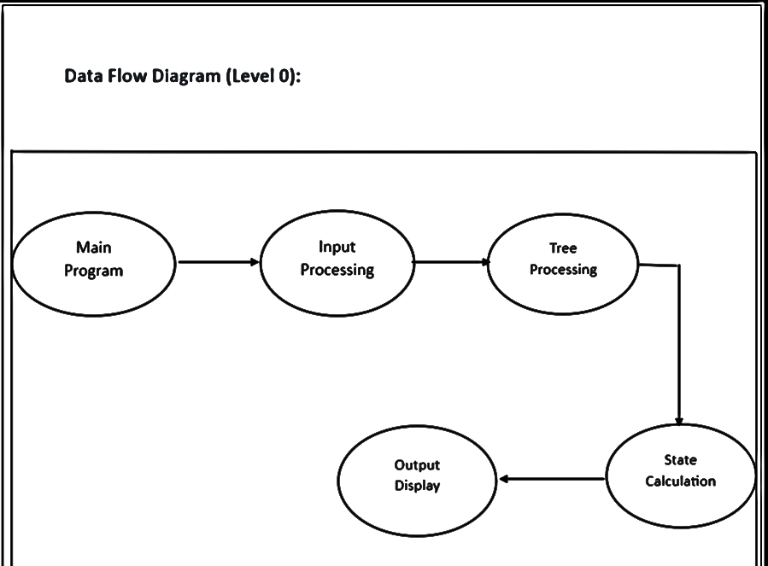
SYSTEM DESIGN
Main program The starting point of the program. It handles the overall flow of control.
Input processing: Read the input data, including the number of nodes, tree edges, edge costs, and nods values.
Tree parsing: Parses the tree structure, edge cost and node values, populates the necessary array, and prepare the data for the further processing.
State calculation: Calls the ‘idiot’ Function, which recursively calculate the state, including minimum increase (‘minInc’), (‘base cost’), and the double heap (‘saving’) Structure.
Output display: Print. The final result based on the calculated state. Considering, condition and adjusting the result for accuracy

Slide 17
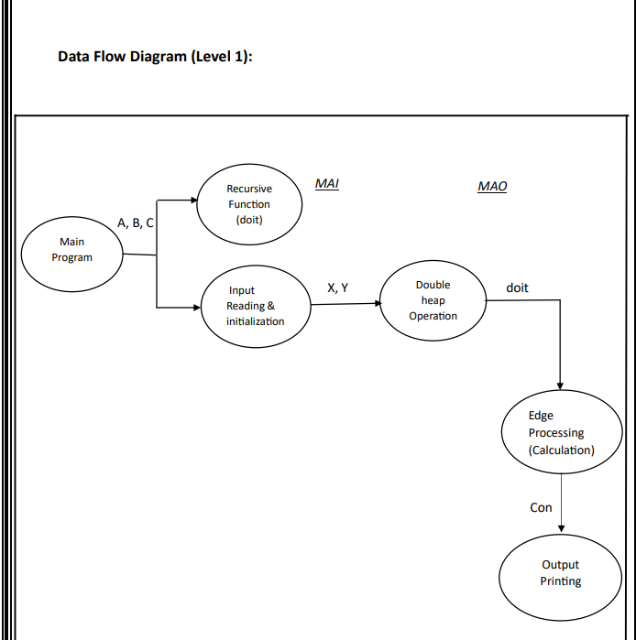
SYSTEM DESIGN
The system follows a dynamic programming approach.
The input is stored in an Array of structures.
Different functions, modules (call by value + call by reference) are present to perform operations on the array and achieve the desired outcome

Slide 18
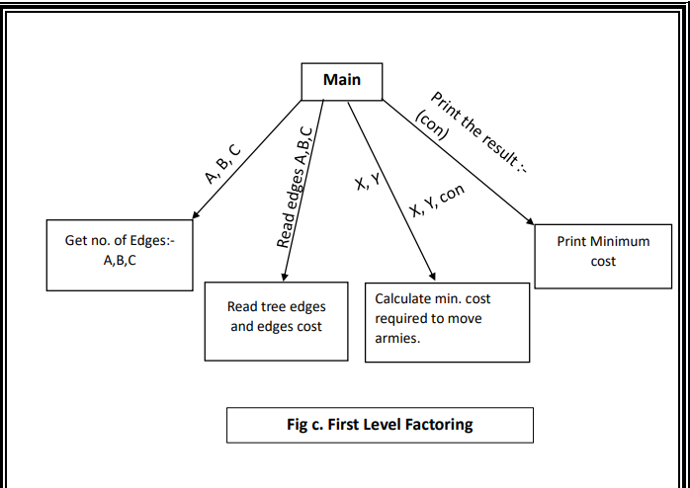
SYSTEM DESIGN
The main goal of the program is to calculate the minimum cost of modifying a given tree structure, where each node has associated value X and Y.
The program optimizes the modification to minimize the increase in value Y while considering associated cost and specific condition.
The result represents the minimum cost required to achieve the desired modification.

Slide 19
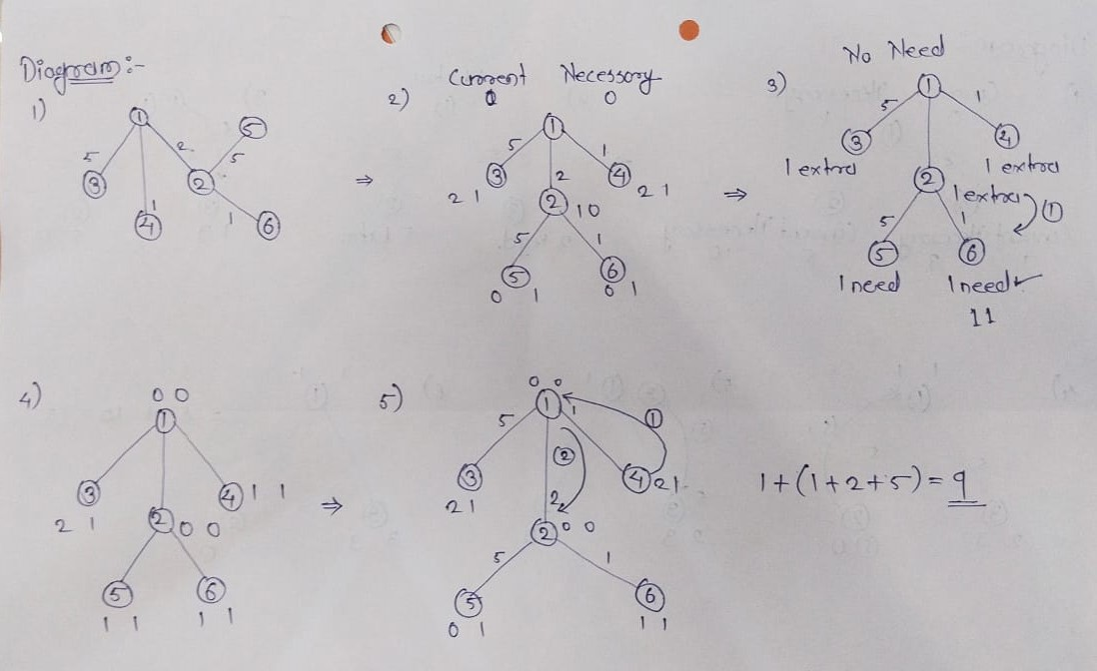
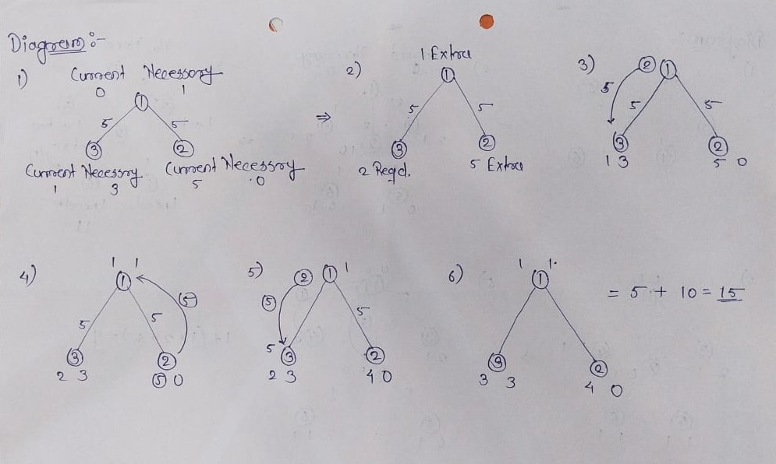
GRAPHICAL REPRESENTATION

Slide 20
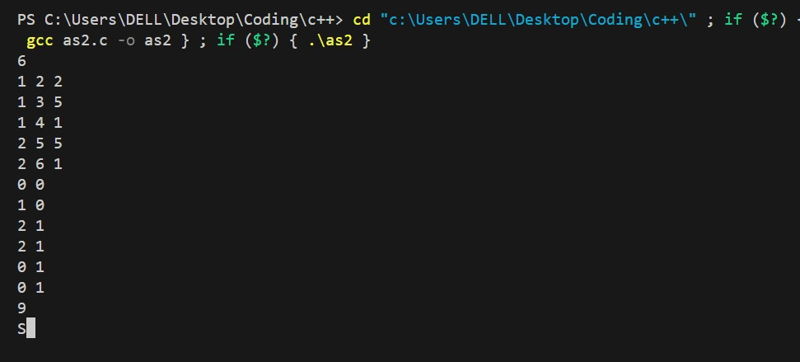
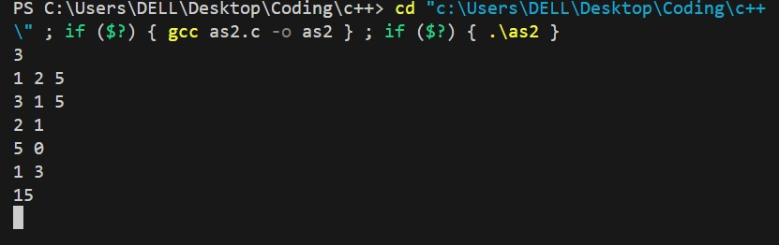
INPUT-OUTPUT

Slide 21
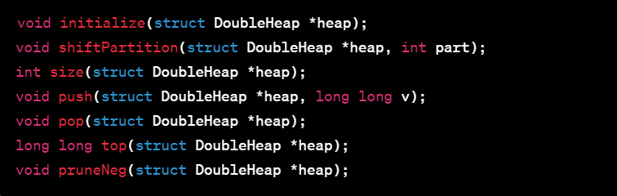
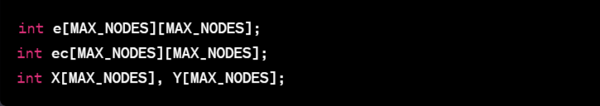
CODE SINNPTS
This defines a constant MAX_NODES with value 100
These are function prototypes for
various operations on the double heap.
Arrays to store nodes and graph values

Slide 22
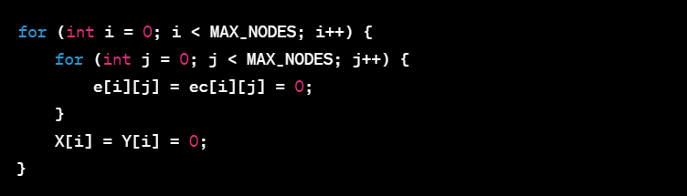
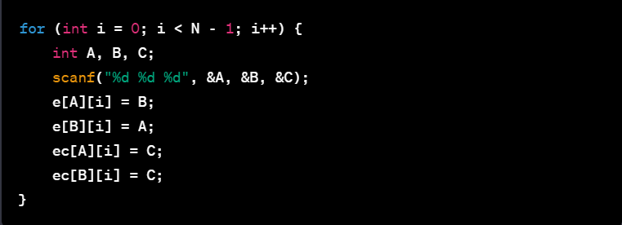
CODE SINNPTS
Reset arrays e, ec ,X and Y to 0
Read tree edges and edge costs for N-1 edges
Populates the array e and ec based on the input

